Slide 1
DevOps for iOS Mobile Apps
Best practices using Jenkins, Xcode, MacInCloud and HockeyApp
Brian Lambert
blambert@microsoft.com

Slide 2
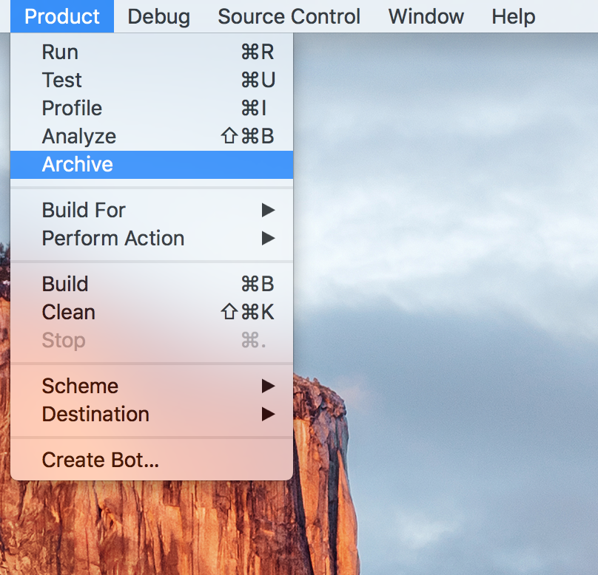
The old way… Before DevOps

Slide 3
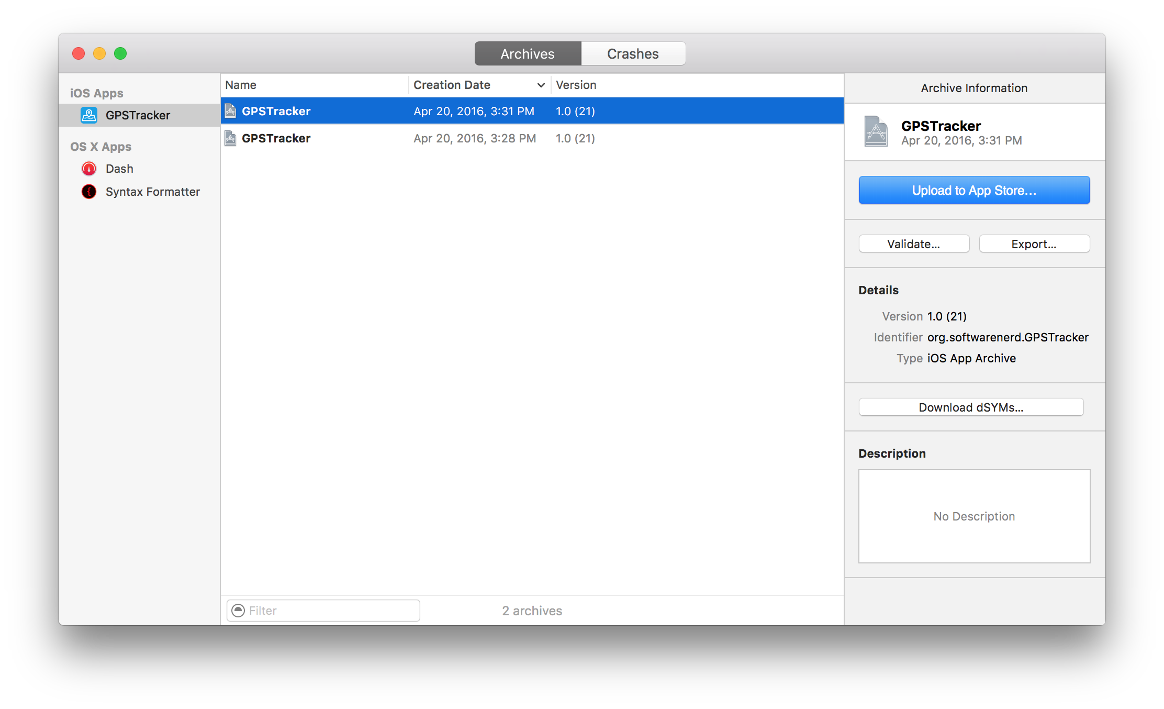
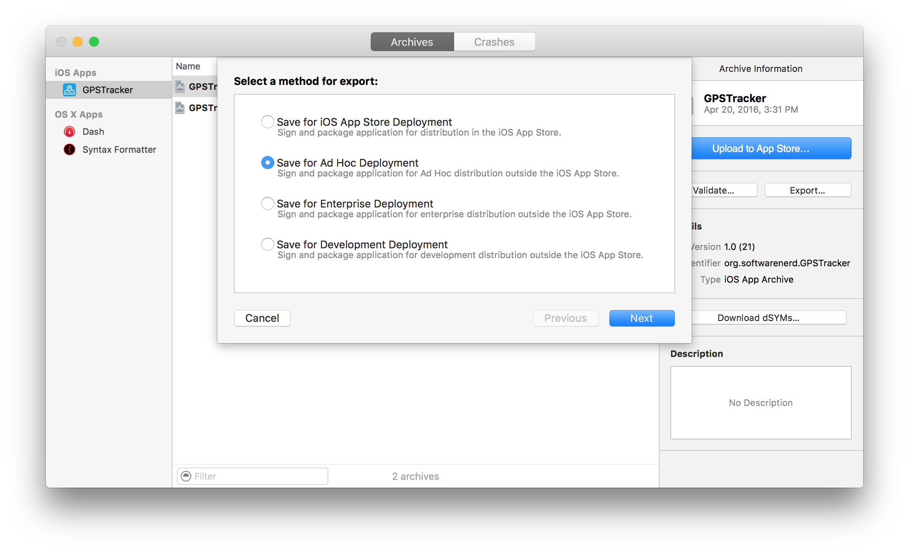
The old way… Before DevOps
Upload Archive / IPA
to TestFlight, HockeyApp

Slide 4
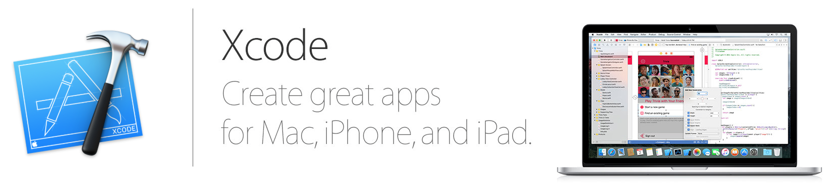
The new way… DevOps on a Build Server
+

Slide 5
Where to run your Build Server To cloud or not to cloud: That is the question.
Cloud advantages:
It’s not your machine - pay monthly / yearly to rent it
Anyone can get to it from anywhere
You remote into it for configuration and management
You call someone when you need support
Cloud disadvantages:
It’s not your machine - pay monthly / yearly to rent it
Anyone can get to it from anywhere
You remote into it for configuration and management
You call someone when you need support

Slide 6
Where to run your Build Server To cloud or not to cloud: That is the question.
Local machine advantages:
It’s your machine, a cheapo Mac Mini / older Mac will often suffice
You can secure it like any other on-prem machine – and keep your eyes on it
There’s no need to remote into it - just walk up to it and log in
You can handle all your support needs yourself
Local machine disadvantages:
Potentially higher initial cost
Highly-distributed team won’t have physical access
Remote access behind corporate firewall will probably be painful to configure

Slide 7
Prerequisites Xcode from the App Store
Xcode command line tools
~/ # Do I have the Xcode command line tools?
~/ xcode-select -p
/Applications/Xcode.app/Contents/Developer
~/ # Yes I do!
~/ # Install Xcode command line tools
~/ xcode-select --install
...
~/ # I do now!

Slide 8
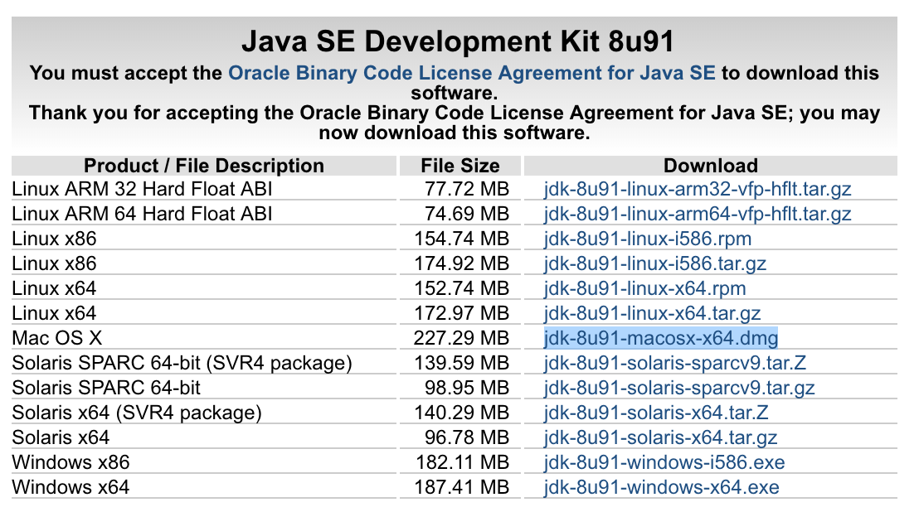
Jenkins Prerequisites Java SDK
A full Java SDK is needed - JRE won’t work as Jenkins uses Apache Ant
Search for “Java SE Development Kit 8 Downloads”
git
~/ # Where’s git?
~/ which git
/usr/bin/git
~/ # It’s right where it should be in /usr/bin

Slide 9
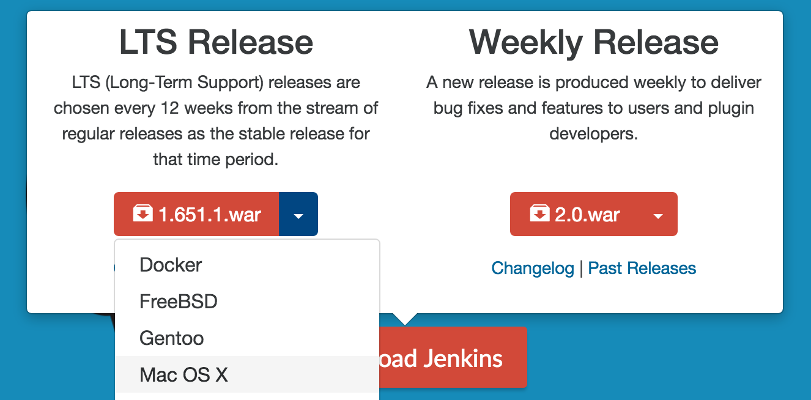
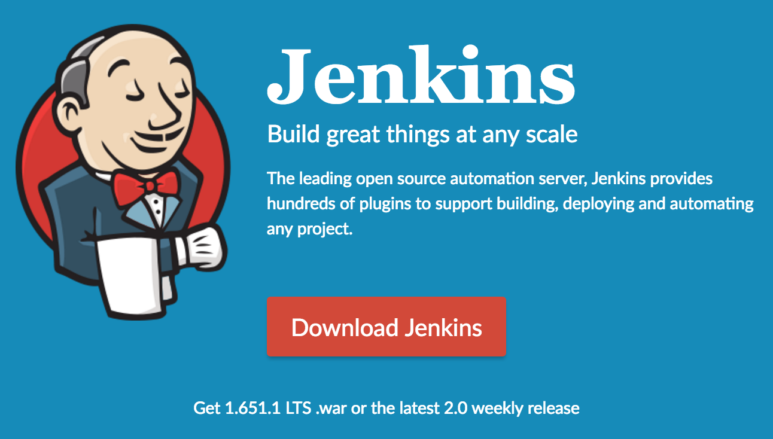
Install Jenkins OS X Installer
Find it at: https://jenkins.io/

Slide 10
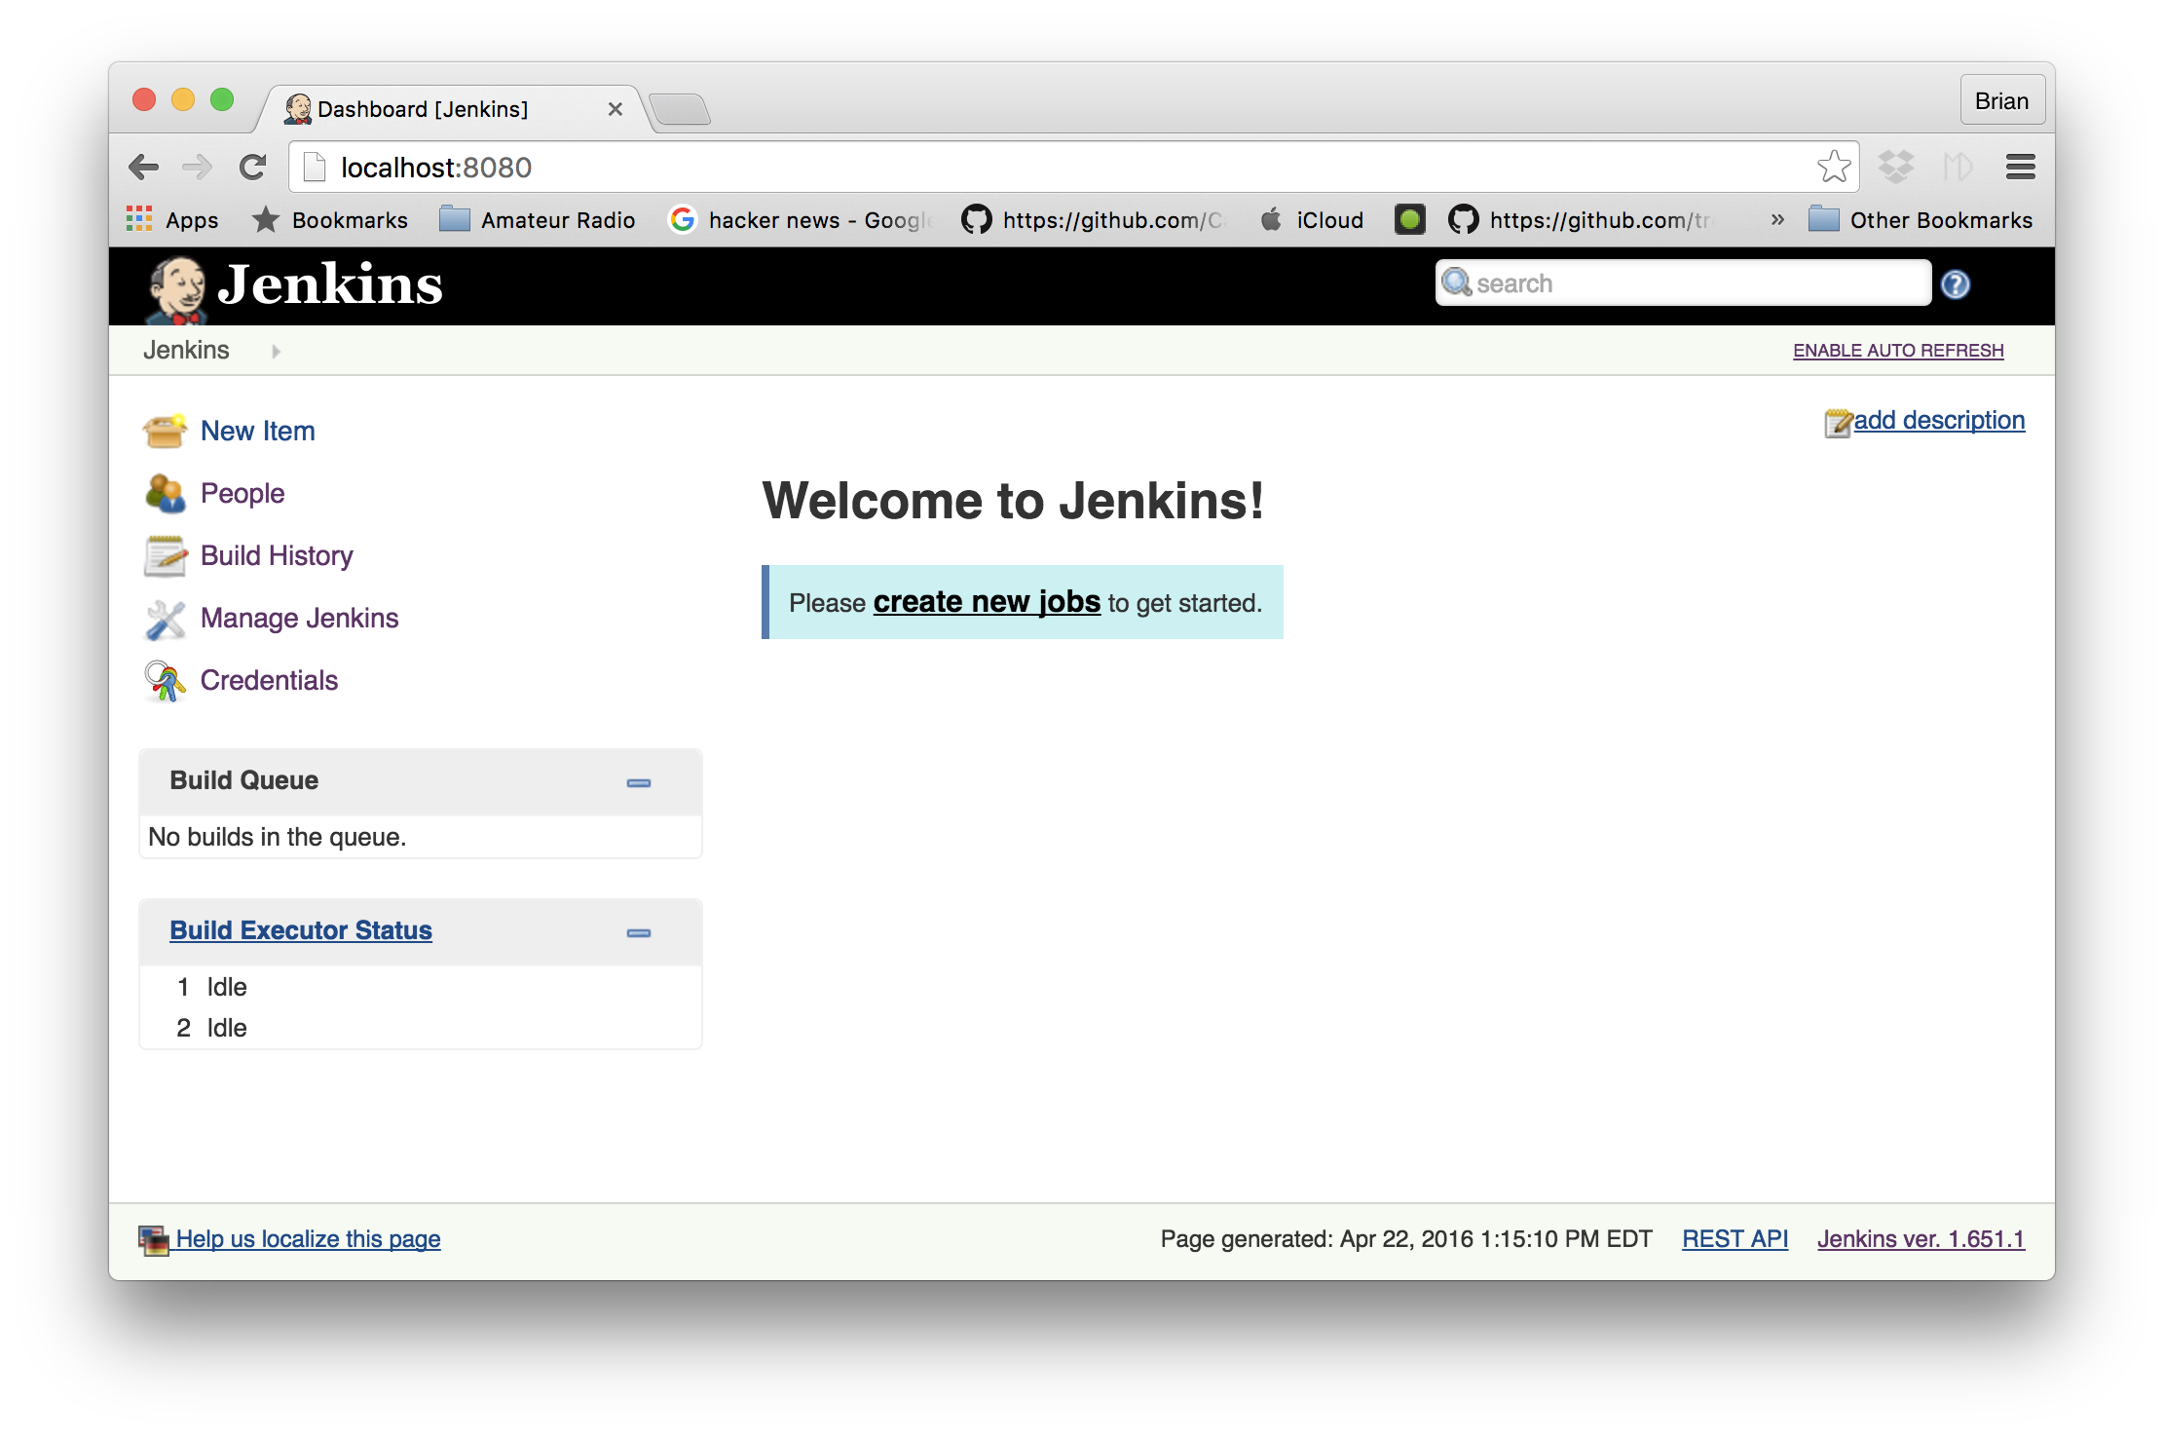
Post Installation Tasks You’re far from done…

Slide 11
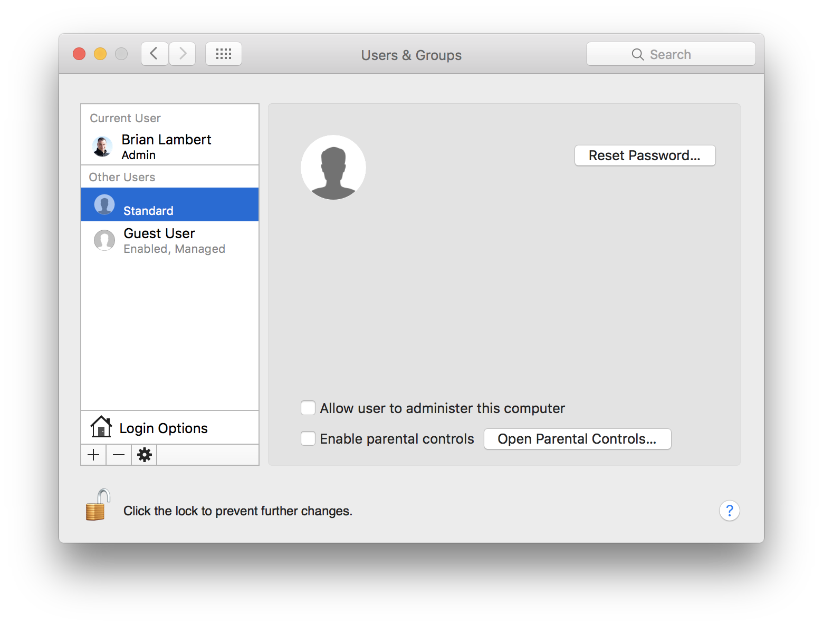
Post Installation Tasks Jenkins Account Jenkins installer creates an account for Jenkins – further configuration is needed:

Slide 12
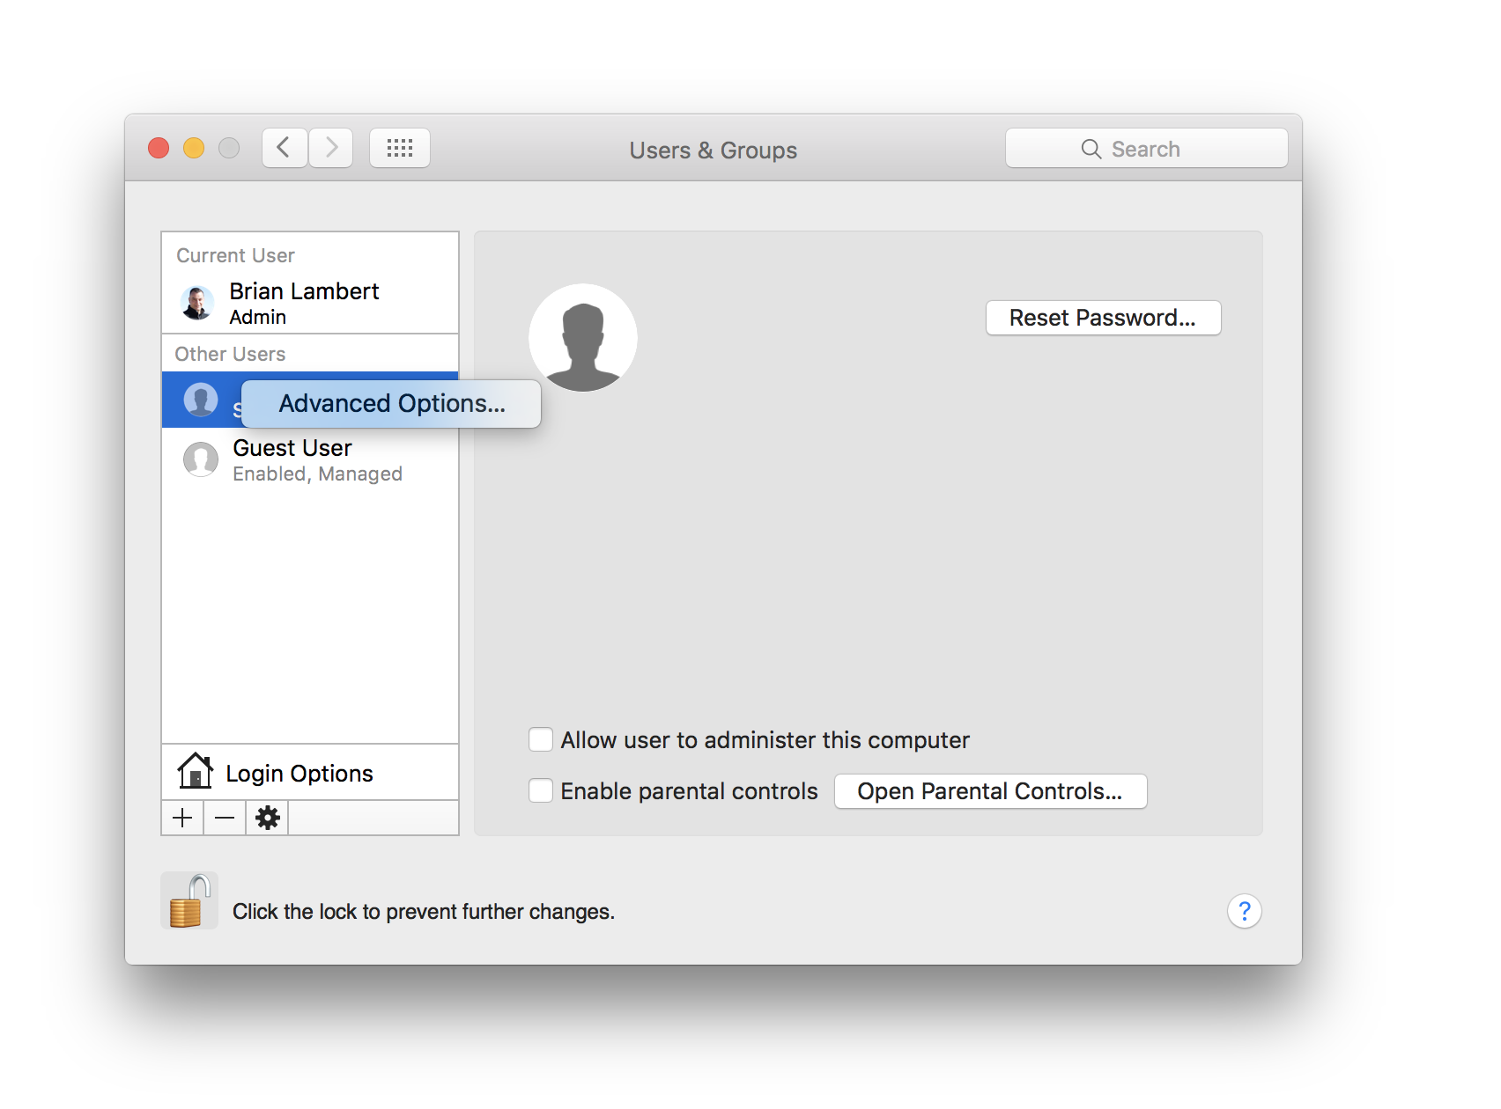
Post Installation Tasks Jenkins Account Open advanced options on the new, unnamed account to configure it:
Right Click

Slide 13
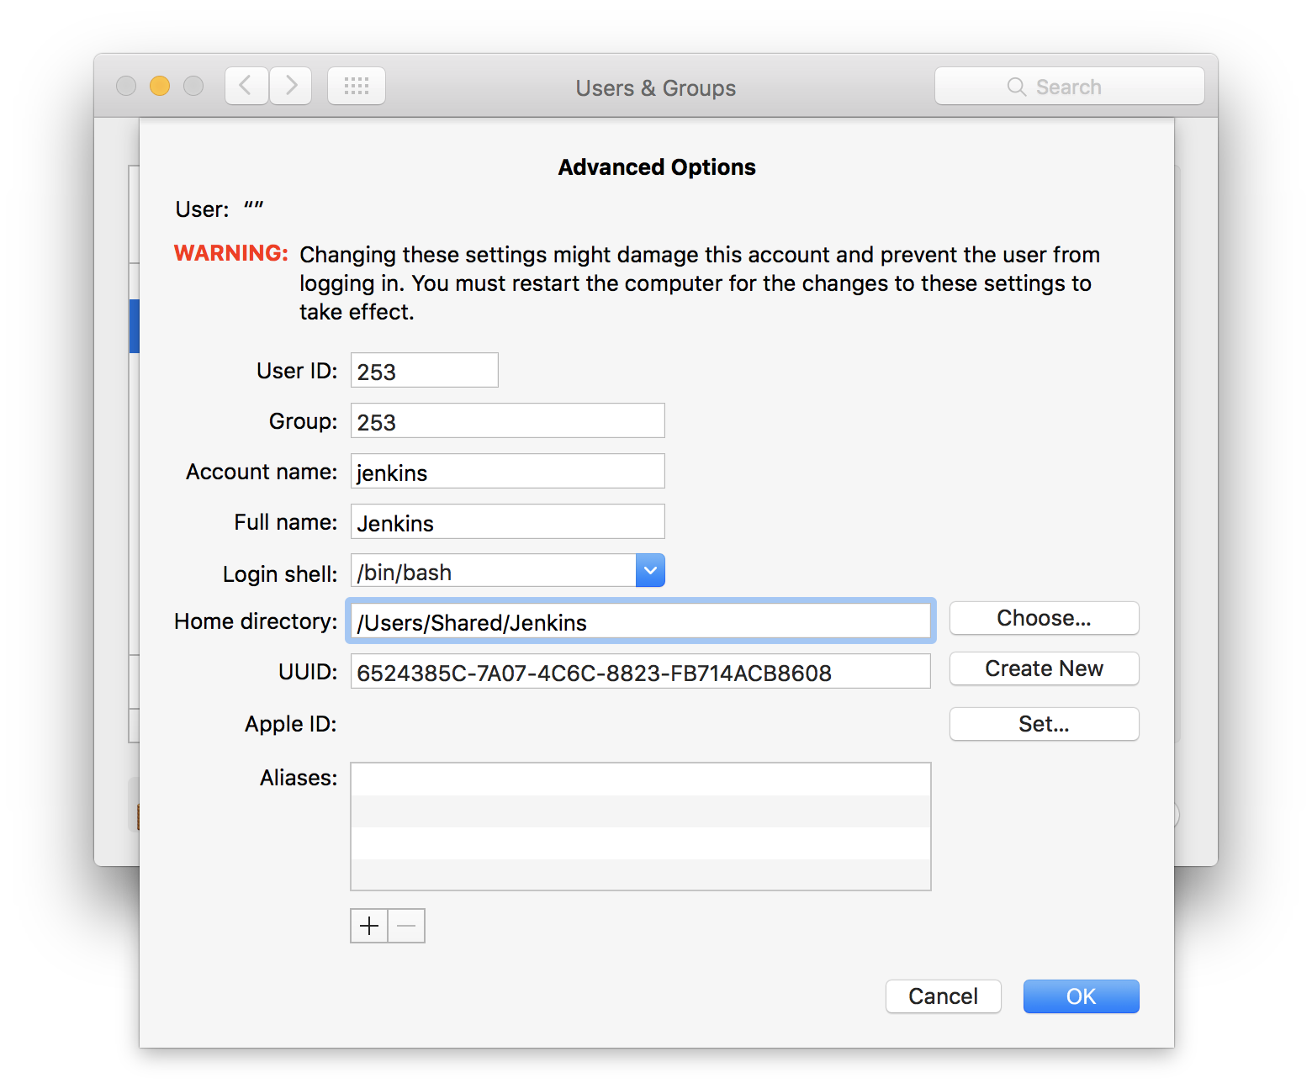
Post Installation Tasks Jenkins Account Give the account a name:
Enter Jenkins here

Slide 14

Post Installation Tasks Jenkins Account Add picture; reset password; make the Jenkins an admin:
Once set-up, you can revert Jenkins
to be a Standard user

Slide 15
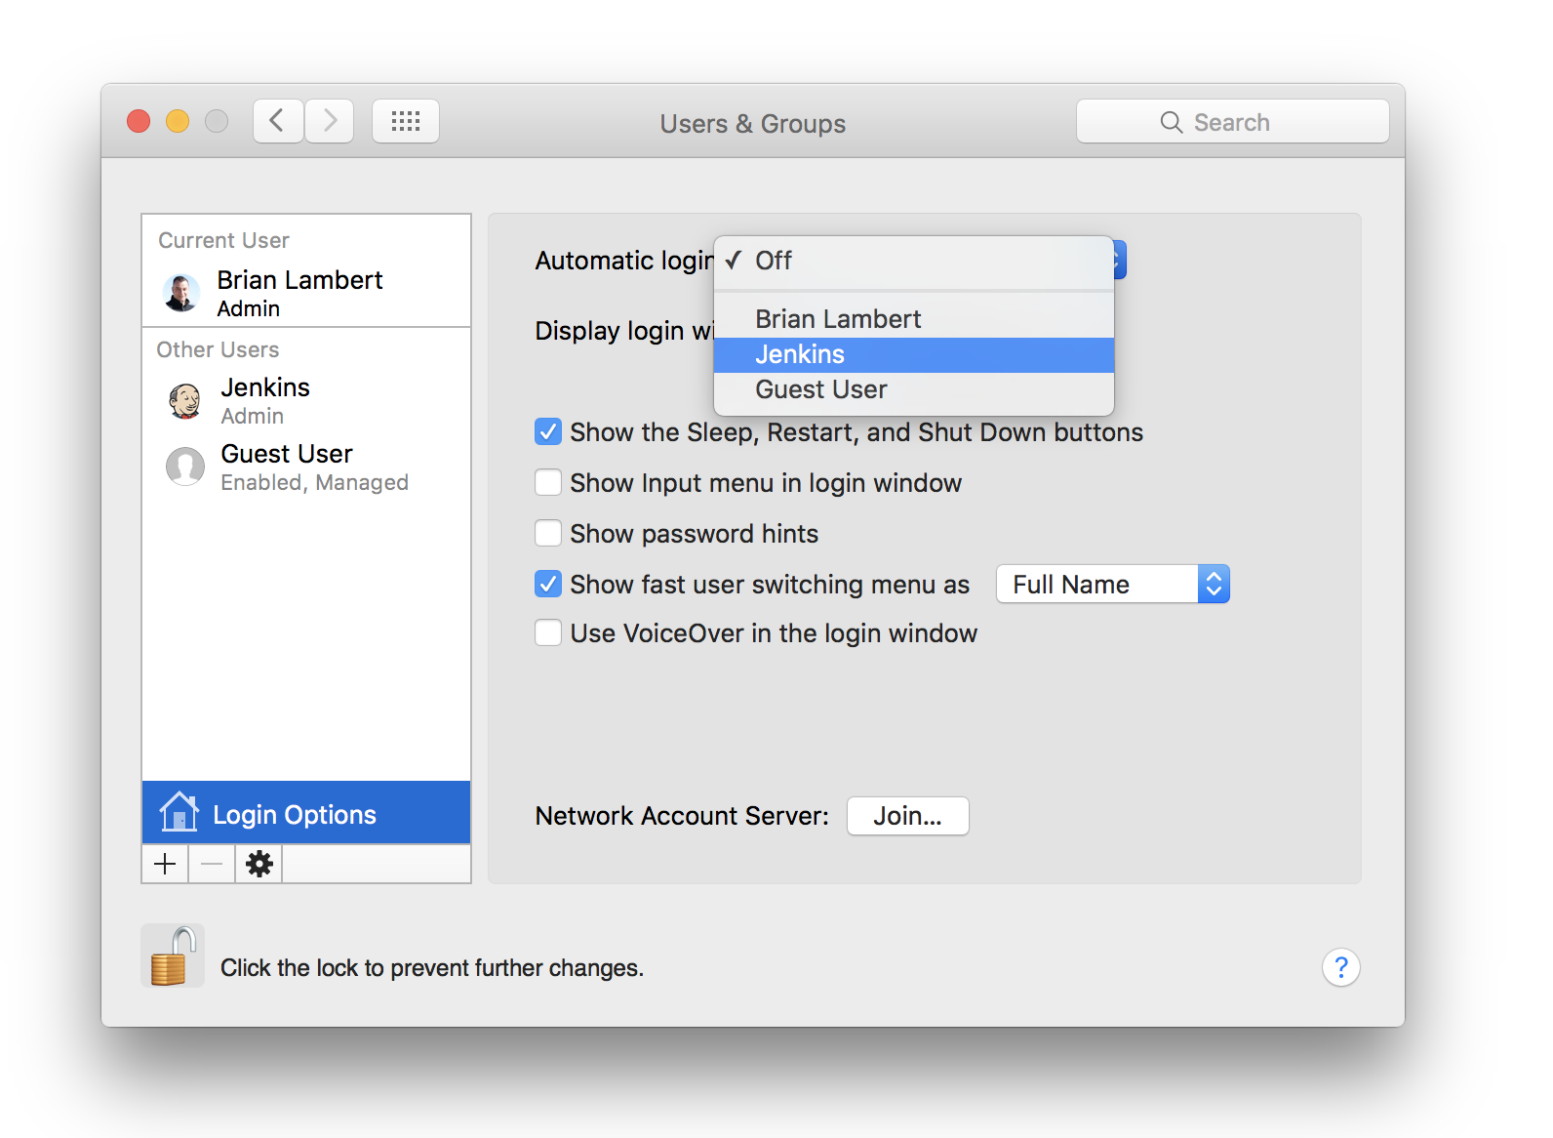
Post Installation Tasks Jenkins Account And, allow Jenkins to automatically log in so it’s always running Enable fast user switching (so you can log in and keep Jenkins logged in)

Slide 16
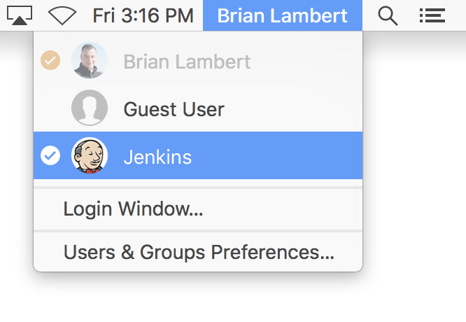
Post Installation Tasks Log into Jenkins account Next you want to log into the Jenkins account so you’re working in it for the next steps – as an admin.

Slide 17
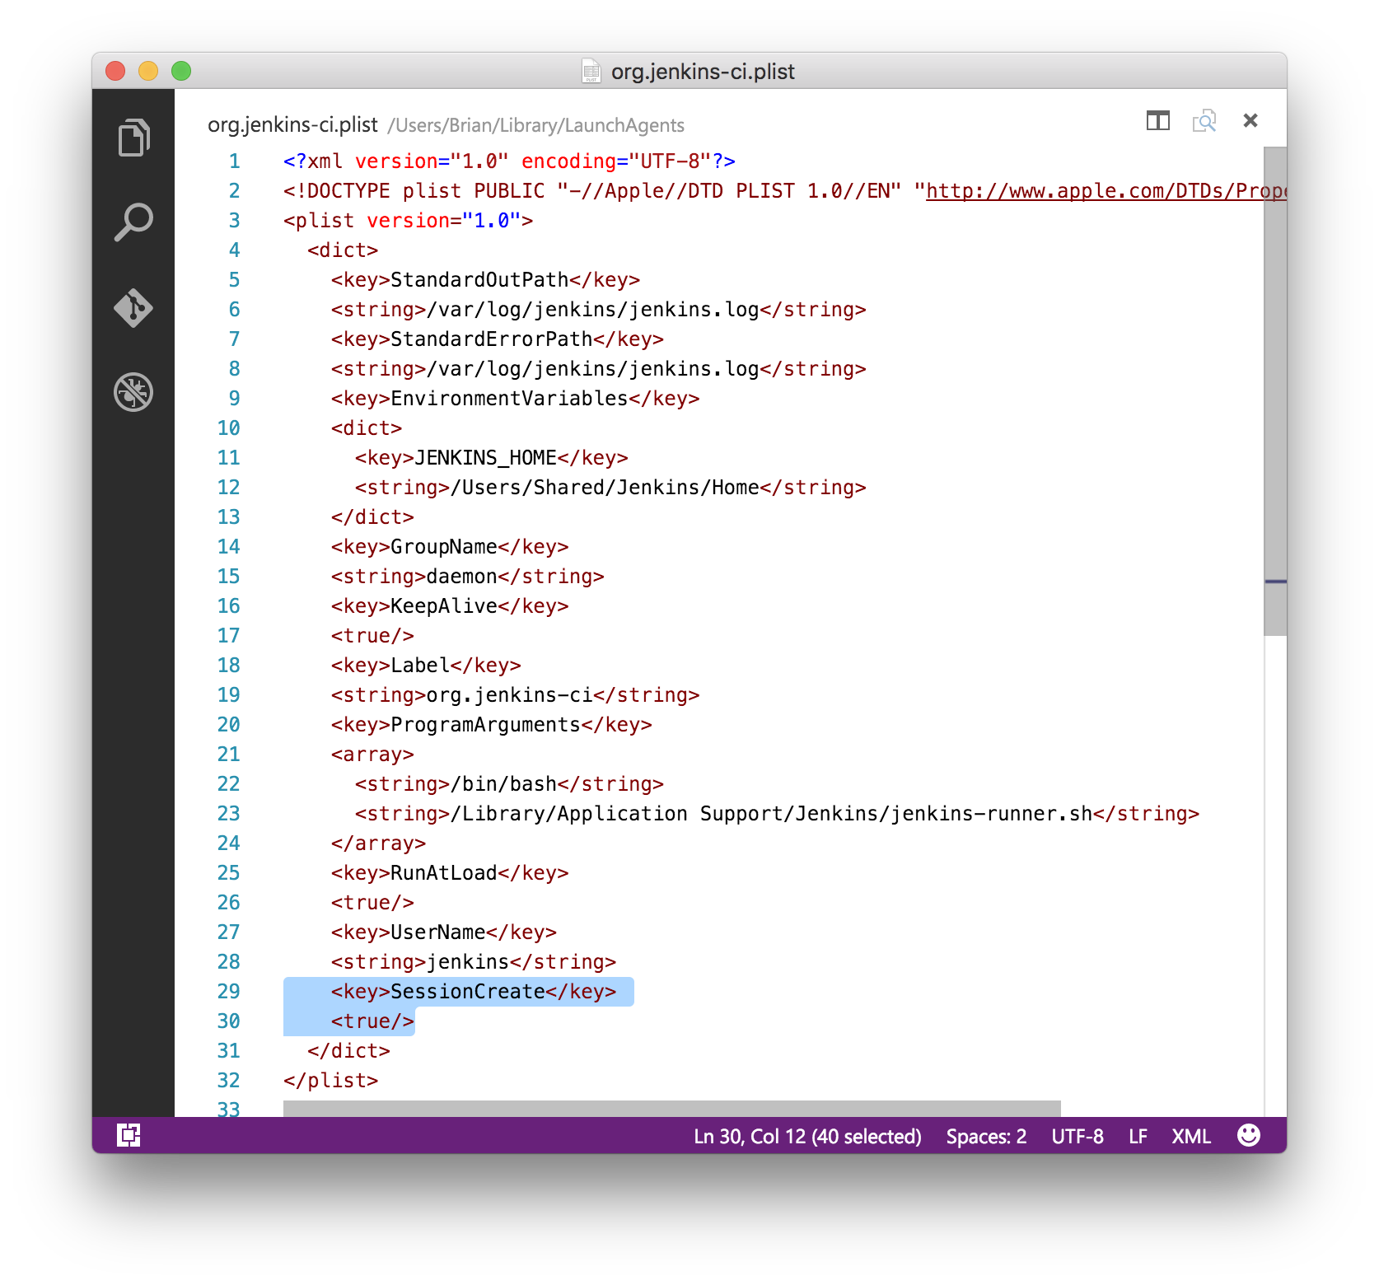
Post Installation Tasks Allow Jenkins to run UI apps properly
~/ # Unload Jenkins (may not be running)
~/ sudo launchctl unload /Library/LaunchDaemons/org.jenkins-ci.plist
~/
~/ # Create a LaunchAgents folder for the Jenkins account (may already exist)
~/ mkdir ~/Library/LaunchAgents/
~/
~/ # Move Jenkins from being a system-wide Launch Daemon (which runs at boot)
~/ # to being a Jenkins Launch Agent (which runs at login to Jenkins account)
~/ sudo mv /Library/LaunchDaemons/org.jenkins-ci.plist ~/Library/LaunchAgents/
~/ ls ~/Library/LaunchAgents/org.jenkins-ci.plist
/Users/Jenkins/Library/LaunchAgents/org.jenkins-ci.plist
~/ # Success!
~/
~/ # Fix the Jenkins config by removing SessionCreate key / value pair
~/ sudo code ~/Library/LaunchAgents/org.jenkins-ci.plist
~/
~/ # Start the Jenkins Launch Agent
~/ sudo launchctl load ~/Library/LaunchAgents/org.jenkins-ci.plist
Remove

Slide 18
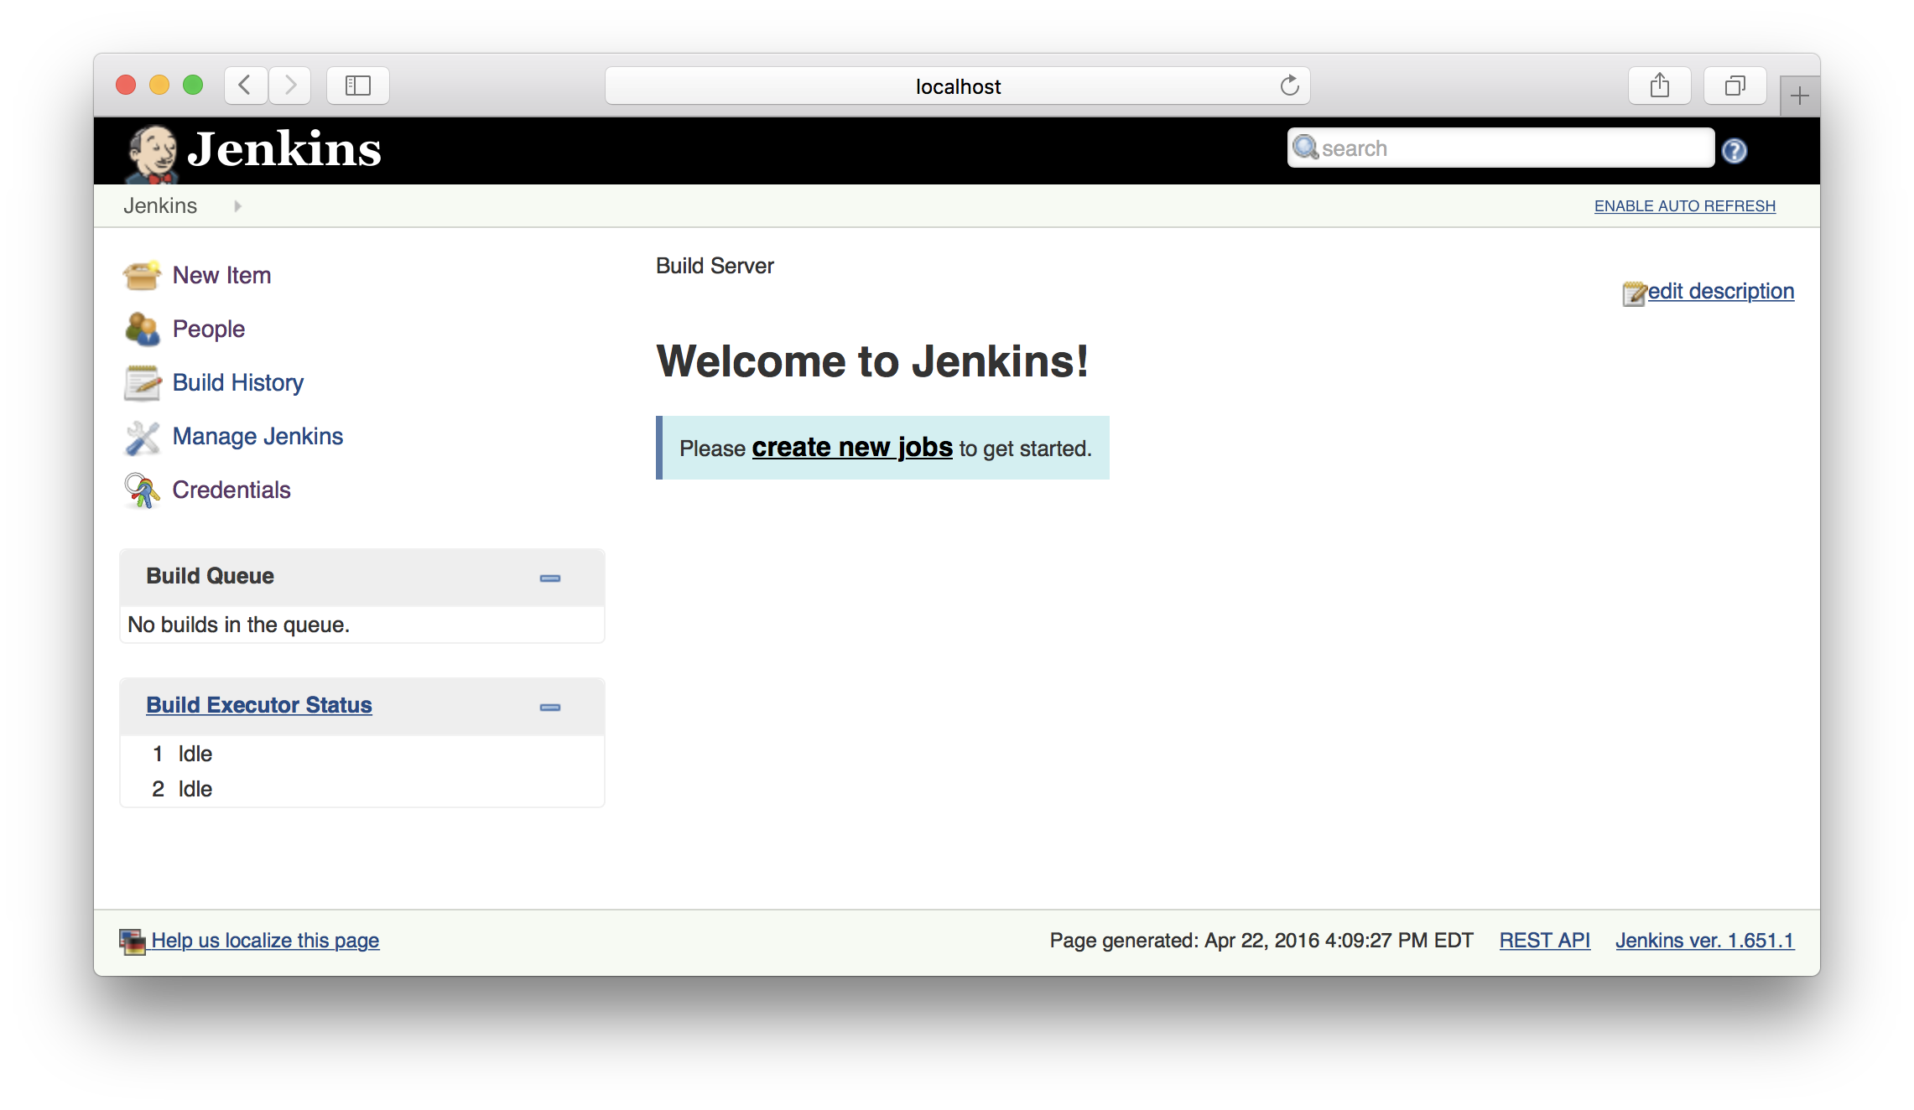
Post Installation Tasks See if you did everything right - http://localhost:8080

Slide 19
Configure SCM git example
~/ git config --global user.name "Joe Jenkins"
~/ git config --global user.email "joejenkins@gmail.com"
~/ ssh-keygen -t rsa -b 4096 -C "joejenkins@gmail.com"
Generating public/private rsa key pair.
Enter file in which to save the key (/Users/Shared/Jenkins/.ssh/id_rsa):
Created directory '/Users/Shared/Jenkins/.ssh'.
Enter passphrase (empty for no passphrase):
Enter same passphrase again:
Your identification has been saved in /Users/Shared/Jenkins/.ssh/id_rsa.
Your public key has been saved in /Users/Shared/Jenkins/.ssh/id_rsa.pub.
The key fingerprint is:
SHA256:m3j8aYUgfmR//rPwFY2K4mPc+JC1D7e7g/nXmVXr5O4 joejenkins@gmail.com
The key's randomart image is:
+---[RSA 4096]----+
| |
| |
| |
| . + .o|
| . +So.. ..+|
| .o.=ooo. oo|
| .oOo+*+ +.=|
| o=+==o+o*.|
| ..++.***E |
+----[SHA256]-----+
~/ # get ~/.ssh/id_rsa.pub up to your git server...

Slide 20
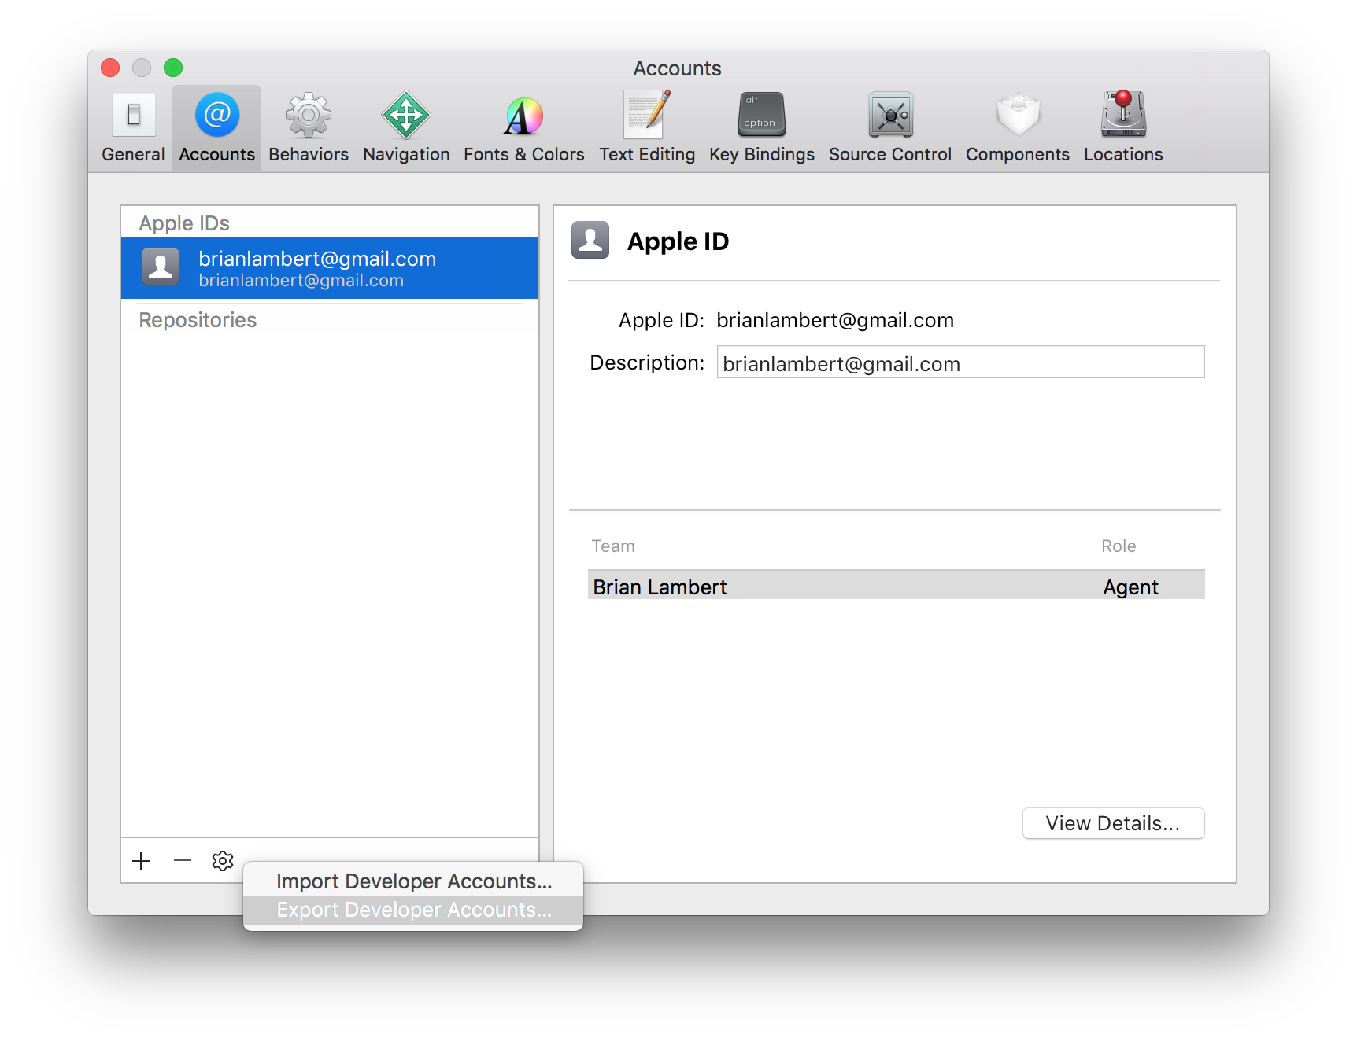
Signing Identities & Provisioning Profiles
Easy way
Export Developer Account(s) from working Xcode
Harder way
Export Developer Certificate(s) via Keychain Access

Slide 21
Configure Xcode on Build Server
Easy way
Import Developer Account
All Signing Identities and Provisioning Profiles
Harder way
Import Developer Certificate(s) via Keychain Access
Download Provisioning Profile(s)

Slide 22
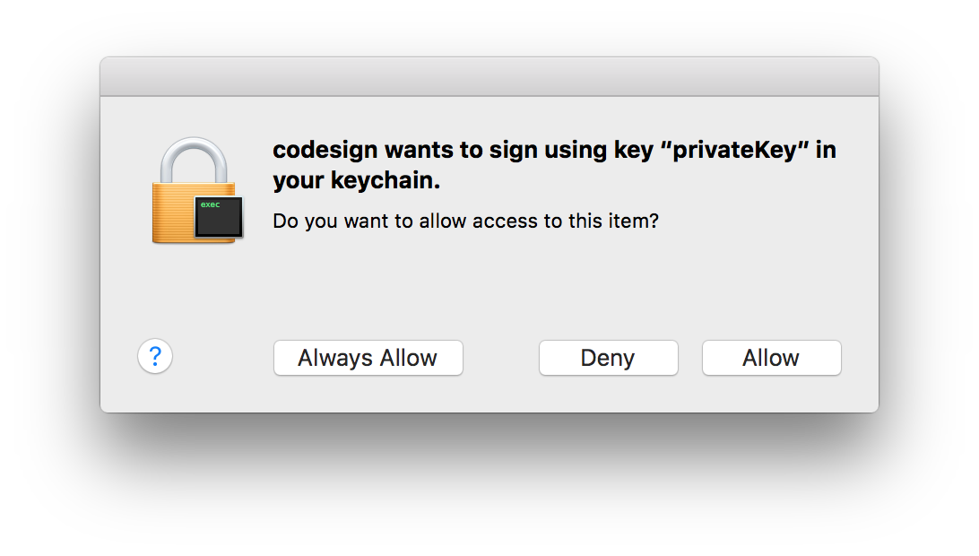
Keychain access to signing certificates
How many of you just click through this without thinking?
It unlocks your private key for the codesign utility!
This needs to be done for Jenkins
It cannot be done via UI when remoted into a machine
A physical mouse must be connected to the machine in order for it to work through UI

Slide 23
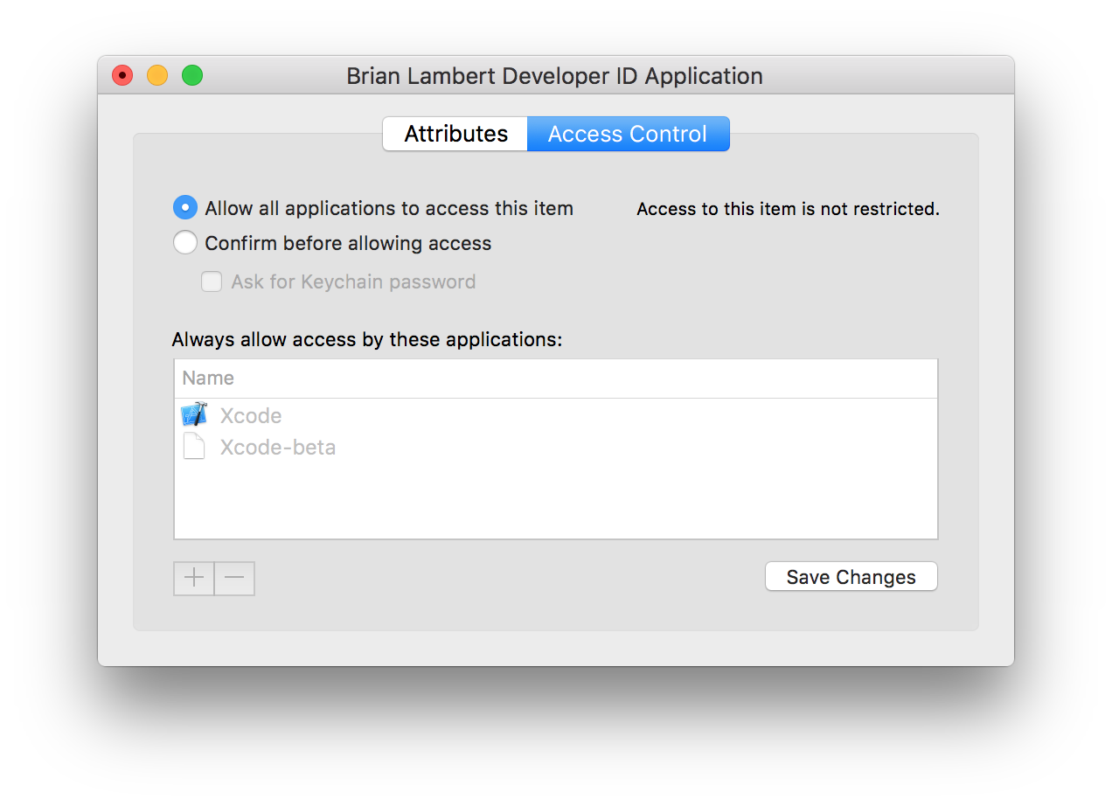
Unlock Keychain for Jenkins
Through UI (doesn’t work via remote access):
While logged into Jenkins
While logged into Jenkins using Xcode
Using Keychain Access Access Control
OR
Through command-line (works via remote access):
~/ # Unlock keychain via command line
~/ security unlock-keychain -p "..." /Users/Shared/Jenkins/Library/Keychains/login.keychain

Slide 24
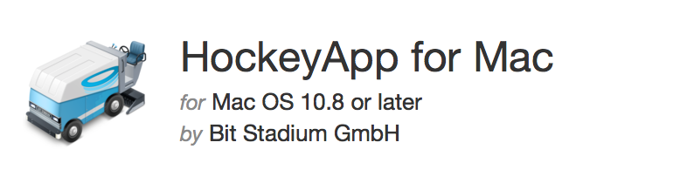
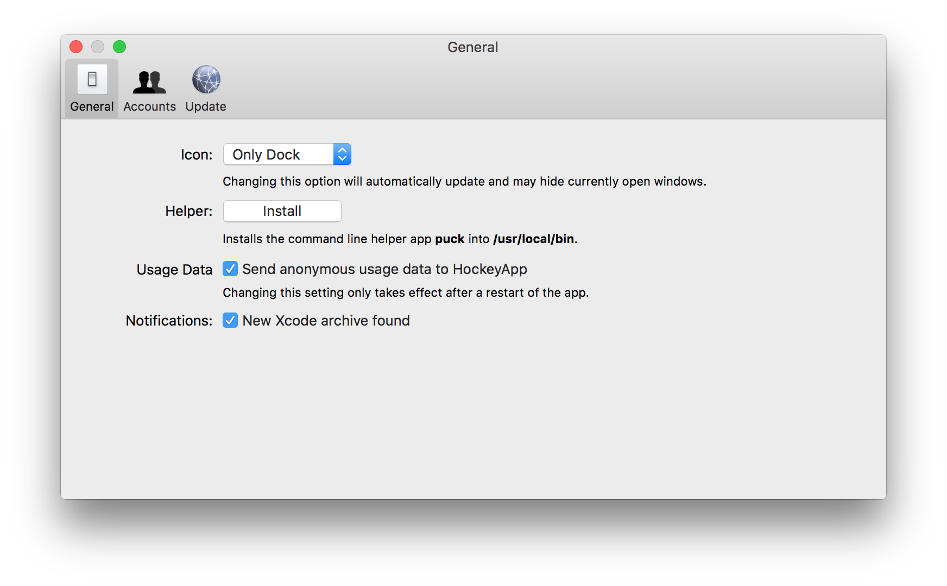
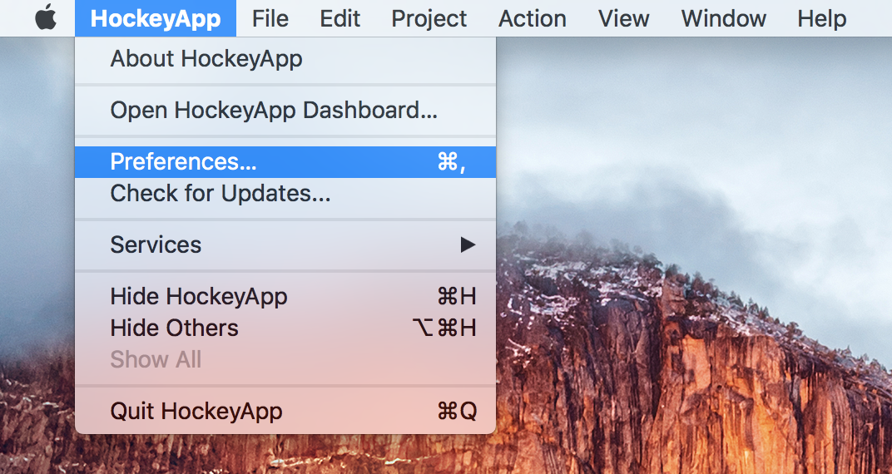
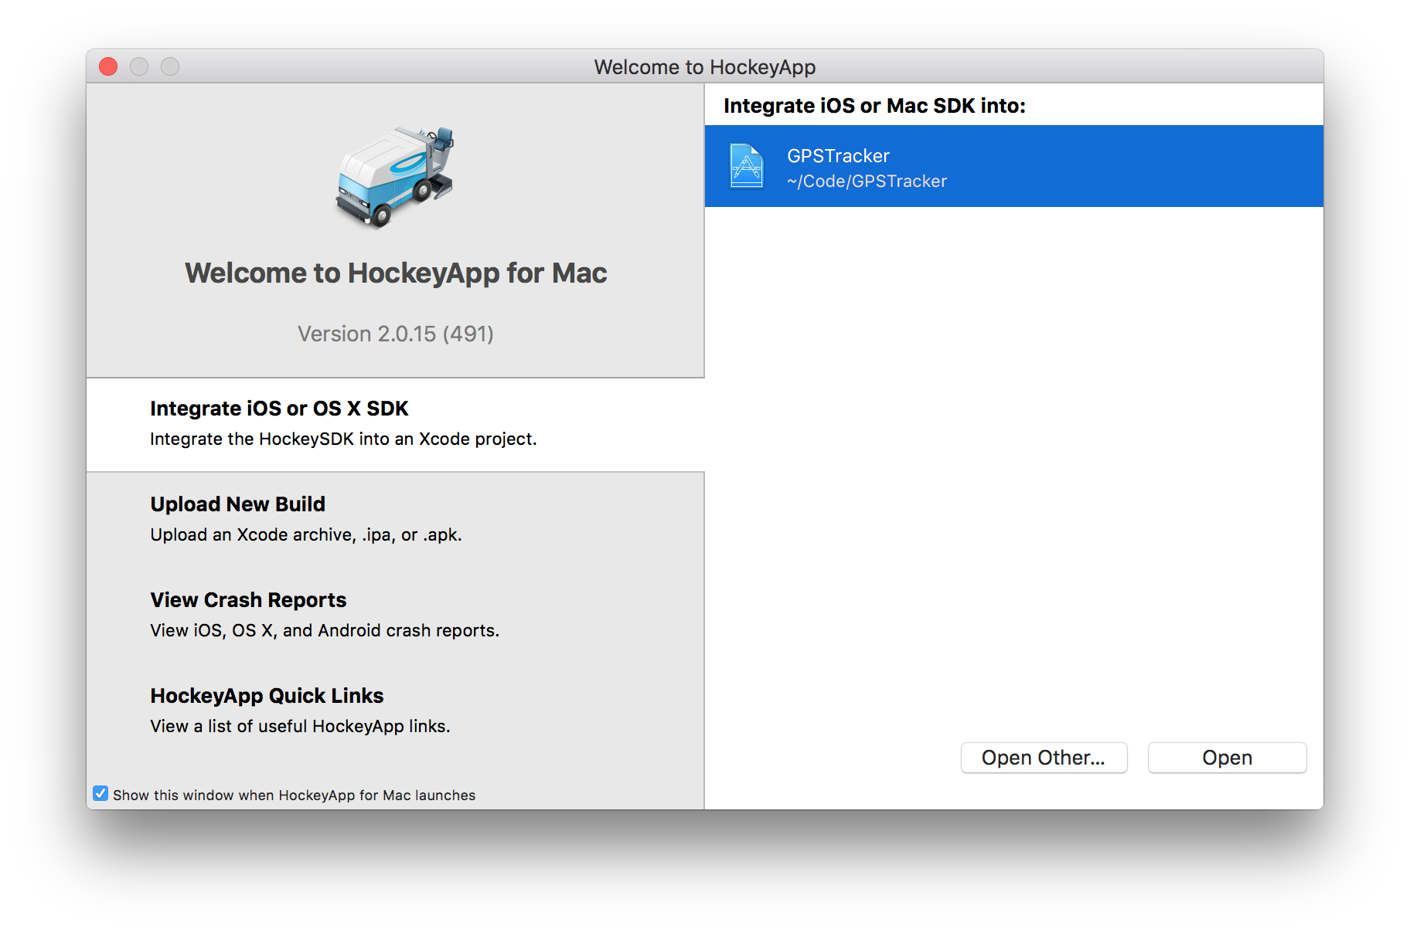
Install Hockey App
Verify availability of HockeyApp command line helper app
~/ # Verify HockeyApp command line helper app
~/ puck -version
Version: 2.0.15 (491)
~/ # It’s installed!

Slide 25
YOU ARE NOW READY TO
CONFIGURE JENKINS!!!!!!

Slide 26
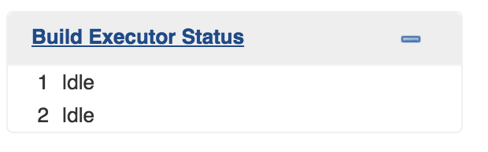
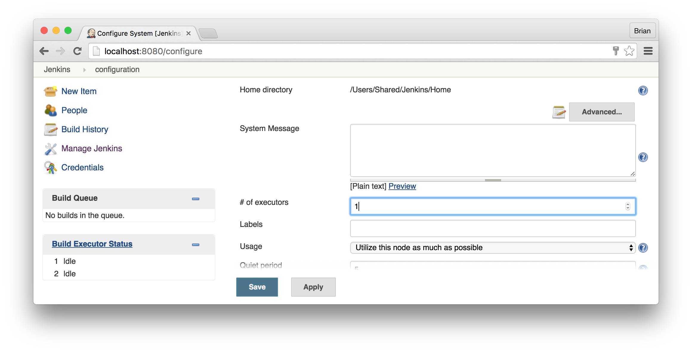


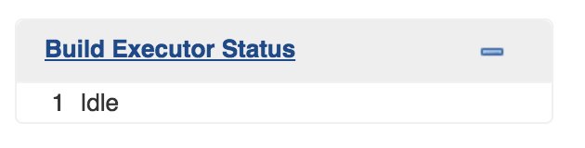
First – There can be only one Build Executor
iOS builds will use iOS simulator for unit and functional tests
Only one iOS simulator can be running at a time
Therefore, only one Build Executor can be used – default is 2
Fix this right away to avoid confusion

Slide 27
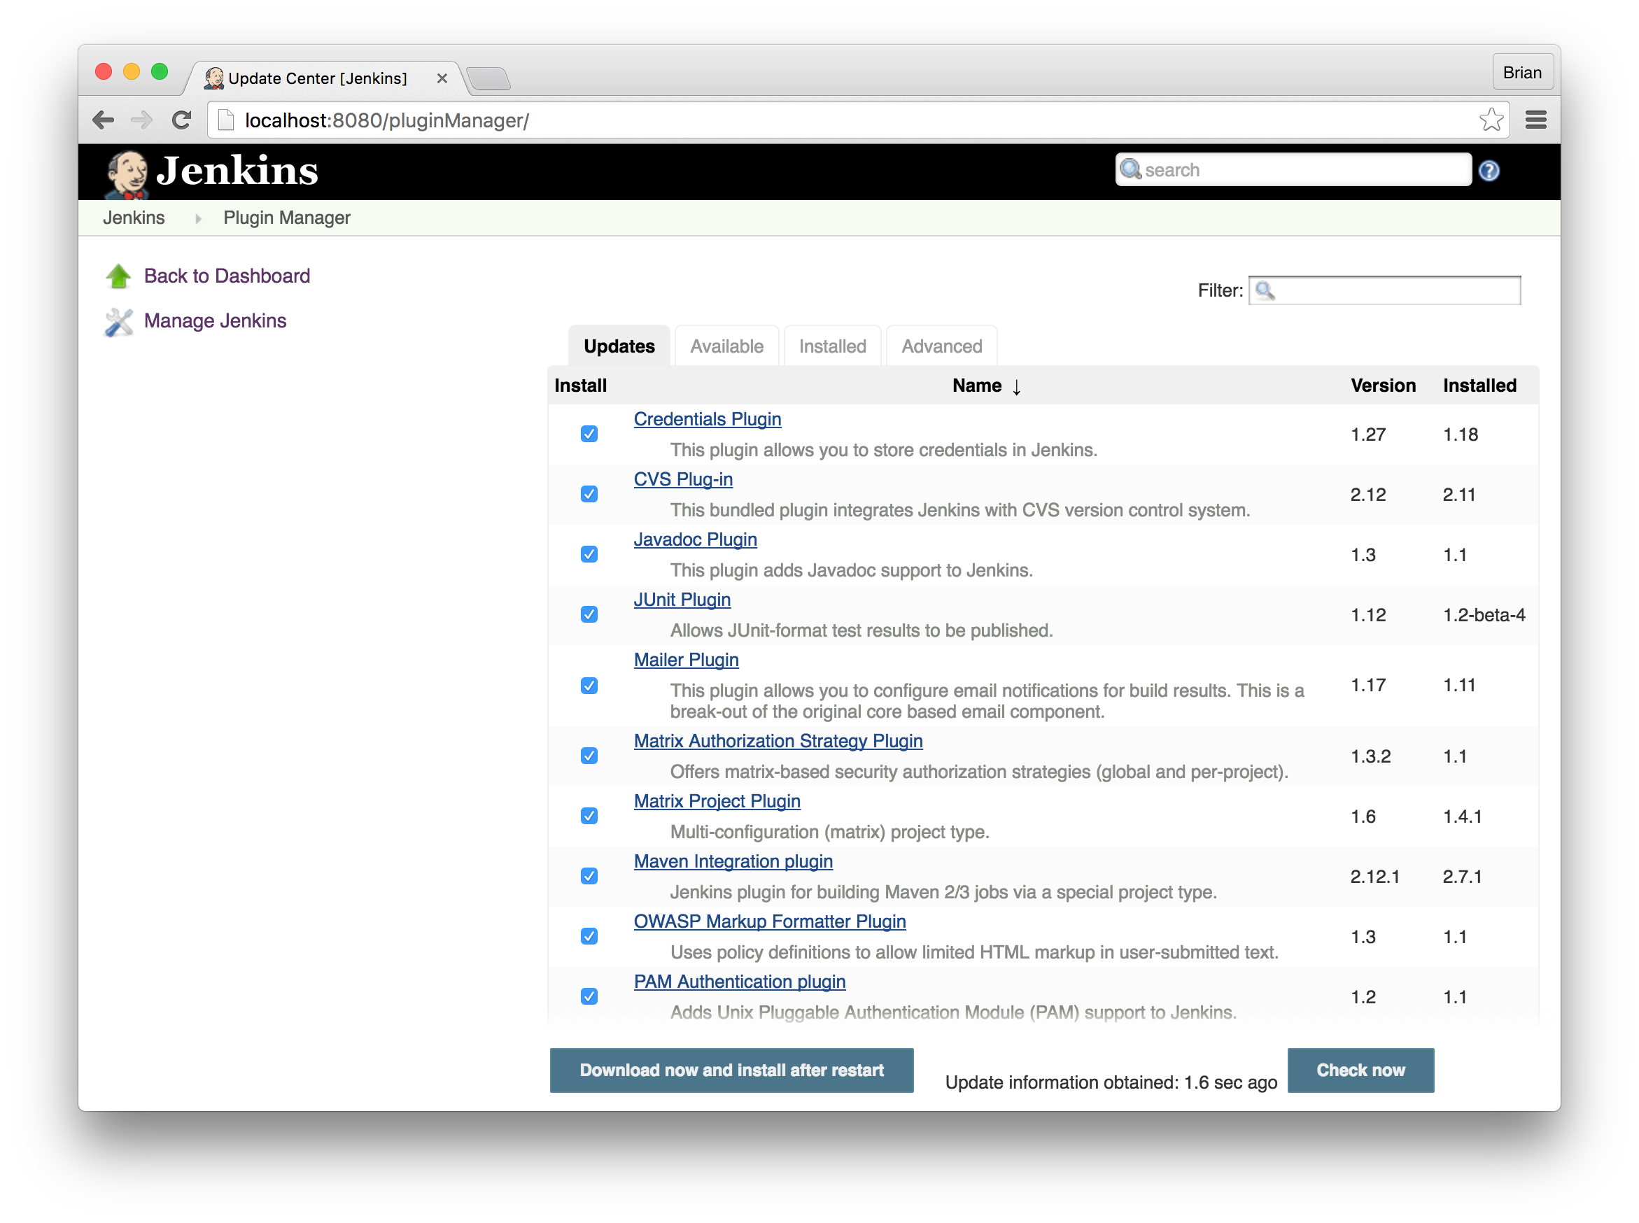
Update Existing Jenkins Plugins
http://localhost:8080/pluginManager/

Slide 28
Install Jenkins Plugins
Core Jenkins Plugins for Xcode Build Automation
https://wiki.jenkins-ci.org/display/JENKINS/Email-ext+plugin
Better email notifications
https://wiki.jenkins-ci.org/display/JENKINS/Environment+Script+Plugin
Allows you to have a script run after SCM checkout, before the build
https://wiki.jenkins-ci.org/display/JENKINS/Github+Plugin
Integrates Jenkins with Github projects
https://wiki.jenkins-ci.org/display/JENKINS/Xcode+Plugin
Adds the ability to call Xcode command line tools from jobs
Add your own Jenkins Plugins for your project
https://wiki.jenkins-ci.org/display/JENKINS/Slack+Plugin
Slack integration
Hundreds of other choices are available…
This is why Jenkins is worth it – you get full control

Slide 29
Configure Your Jenkins Jobs!
Live Demo Time

Slide 30
Questions?

